Slide 1



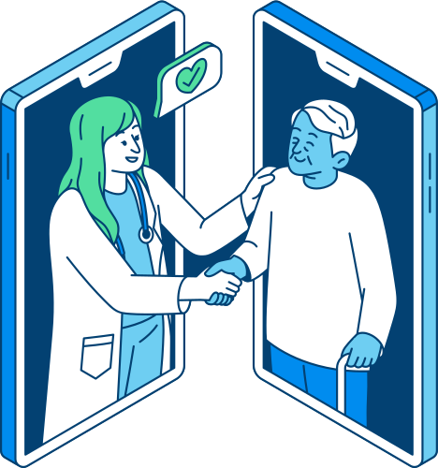



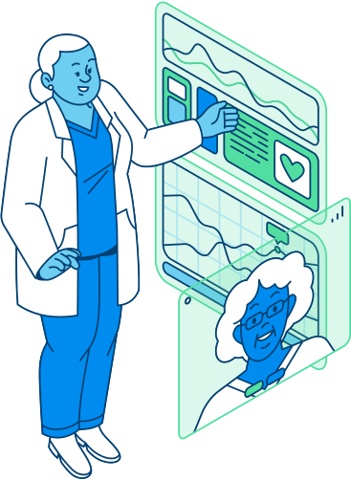
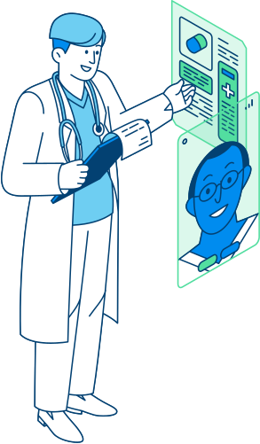
Symptom
Analyzer
Presented By :
Saurabh Lakhanpal, Evan Gowans, Melanie Liao

Slide 2
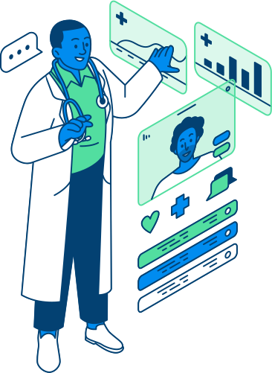
Project Break Down
Data Preparation & Resources
Model Development & Storage
Prepared structured data by generating synthetic patient data based on the Disease Symptom Knowledge Base (DSKB).
Ensured clinical realism by simulating partial symptom presence and adding controlled noise for variability.
Built and trained a dense neural network using TensorFlow.
Saved the model, scaler, and feature encodings to deploy predictions in real-time.
Backend API Development
Frontend Web Application
Developed a Flask API connected to a PostgreSQL database.
Serves symptoms, diseases, and model predictions through structured endpoints.
Created an interactive web app using HTML, CSS, and JavaScript.
Users can search symptoms, analyze results, and view top disease matches with probabilities.

Slide 3
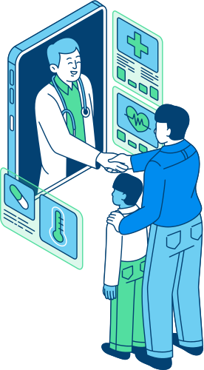
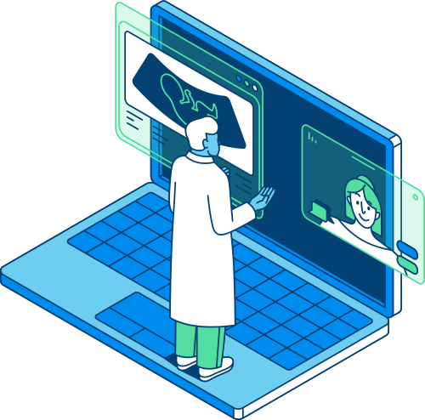

Project Objective
Problem Statement
Patients often turn to generic online searches for health concerns, leading to anxiety and misinformation.
There is a need for a reliable tool that can predict diseases based on symptom input, reducing uncertainty and improving user trust.
Project Objective
Develop a machine learning-powered web application that:
Accepts symptoms from users.
Predicts the top 3 most likely diseases with probability scores.
Provides related symptoms to refine and improve predictions.
Offers a more accurate alternative to broad, unreliable online symptom searches.

Slide 4
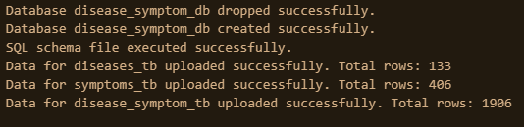
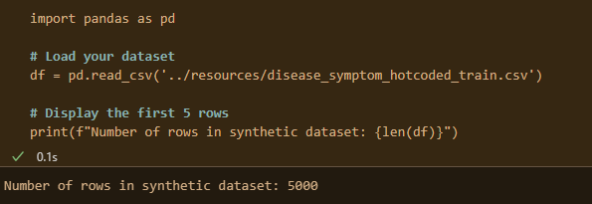
Dataset Overview
Dataset:
Disease Symptom Knowledge Base (DSKB)
Content:
149 diseases
407 symptoms
5,000 synthetic mock patient records
Format:
CSV files
Web Scraping
Symptoms hotcoded into binary columns (1 = symptom present, 0 = absent)
Why DSKB?
Provides structured, rich labeled data ideal for supervised machine learning.

Slide 5
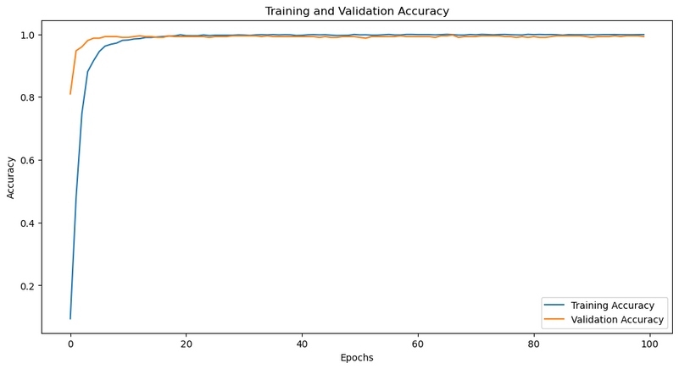
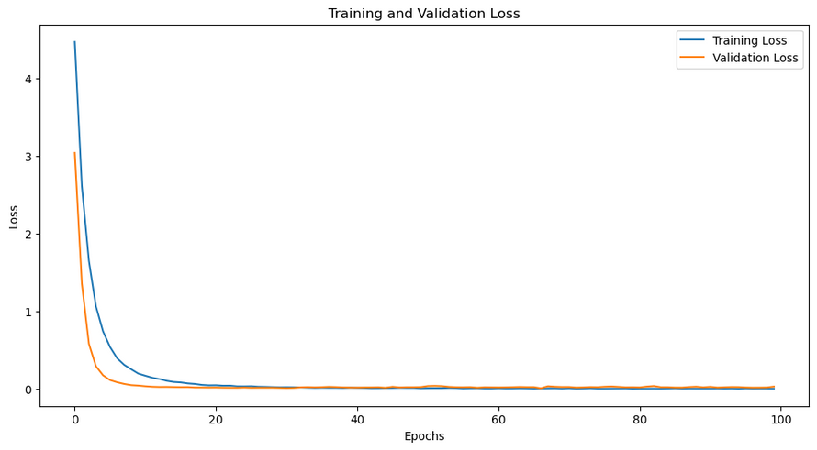
Technologies & ML Architecture
Technologies Used
Machine Learning: TensorFlow, Scikit-learn
Data Handling: Pandas, NumPy
Backend: Flask, SQLAlchemy, PostgreSQL
Frontend: HTML, CSS, JavaScript
Dev Tools: Google Colab, GitHub, AWS (planned deployment)
Machine Learning Model Architecture
Model Type: Dense Neural Network (Multiclass Classification)
Structure:
Input: 407 symptom features
3 Hidden Layers (ReLU activation, Batch Normalization, Dropout)
Output Layer: Softmax activation (149 disease classes)
Training:
Loss: Categorical Crossentropy
Optimizer: Adam
Data: 5,000 synthetic patient rows
Model Performance:
Training Accuracy: 99.88%
Validation Accuracy: 99.25%
Training Loss: 0.0063
Validation Loss: 0.0315

Slide 6
Synthetic Data Generation
Objective: Generate artificial data mimicking real-world patient charts for machine learning and testing.
Outcome: A 5,000-row synthetic dataset with diverse disease-symptom profiles, ready for algorithm training and testing.
Created mock charts linking diseases to their symptoms.
Ensured variability by assigning 33%+ of symptoms to each disease.
Created mock charts linking diseases to their symptoms. Ensured variability by assigning 33%+ of symptoms to each disease.
Step 1: Simulating Patients
Step 2: Introducing Noise
Mimics variability in clinical data
Builds robust models for real-world applications.
Reflects thresholds used in diagnostic frameworks (DSM-5: ~30–50% of symptoms; ACR for lupus: ~36–40%)
Step 3: Why Noise Matters
Step 4: Real-World Alignment

Slide 7
Demo
Features of the Web App
Workflow Overview
Symptom Search:
Autocomplete search bar linked to a database of 407 symptoms.
Disease Prediction:
Predicts the top 3 diseases with probability scores based on selected symptoms.
Related Symptom Suggestions:
Suggests additional symptoms for refining predictions.
Reanalyze and Refine:
Users can add new symptoms and instantly update their results.
Lightweight Frontend:
Built with pure HTML, CSS, and JavaScript.
Fast, responsive, and mobile-friendly design without heavy frameworks.
Step 1: Data Preparation (ETL)
Cleaned and loaded disease-symptom data into a PostgreSQL database.
Step 2: Synthetic Patient Generation
Created 5,000 mock patients with ≥33% disease symptoms and controlled noise.
Step 3: Model Training
Trained a dense neural network on synthetic patient data.
Step 4: Model Export
Saved trained model (.h5) and preprocessing tools (.pkl).
Step 5: Backend API (Flask)
Built API endpoints to serve real-time predictions from the model.
Step 6: Frontend Integration
Web app connects user symptom input to API and displays top 3 disease predictions.

Slide 8



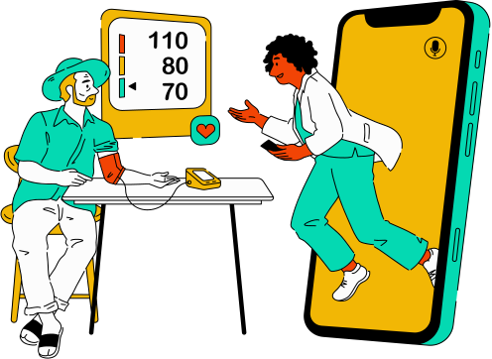




Challenges Faced
Managing imbalanced data (some diseases have fewer symptoms & ranking system).
Choosing model complexity (not overfitting on mock patients).
Cross-environment compatibility (TensorFlow versions, Python versions).
Backend and frontend integration (CORS, API security).

Slide 9




Key Learnings
Next Steps
Building and serving a deep learning model in a real-world app.
Handling full-stack architecture (frontend, backend, model).
Team collaboration with Google Colab.
Importance of user-centered design for health-related apps.
Train on real patient data (if available) for even better accuracy.
Add ranking for better predictions
Deploy to cloud server (AWS/GCP) for public use.
Add user accounts and prediction history saving.

Slide 10
Thank You

